Slide 1
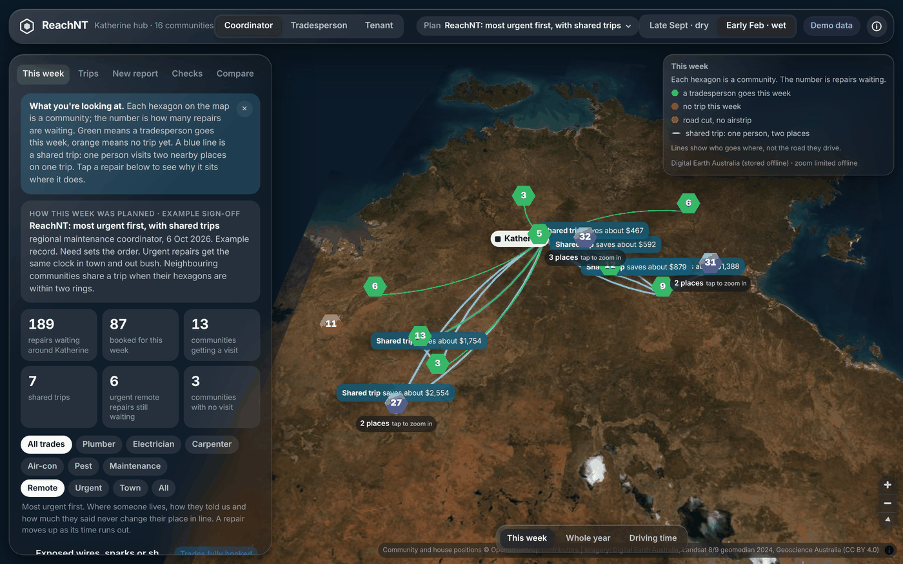
ReachNT
Urgent repairs fixed on time out bush, without letting cost quietly decide who waits
Harsh Rastogi · Aashish
reachnt.vercel.app
Notes:
[HARSH, about 30 seconds]
Good morning. I'm Harsh, this is Aashish, and we're Team Top Enders.
Imagine a family in a remote community in the Northern Territory. The water to their house stops. They ring the repairs line. In town, a plumber would be there in a couple of days. For them, it can take weeks.
Our project, ReachNT, is about why that happens, and what AI can do about it. Aashish will start with the problem.

Slide 2
Remote repairs cost more, so they quietly fall to the back
70
8.5×
96%
6 h
remote communities in our model, with 4,481 public houses
what an emergency repair costs in a very remote community, against a remote one (Nous Group, 2017)
of an emergency job's cost can be travel alone (Nous Group, 2017)
drive from Katherine to Kalkarindji, one of the 16 communities its tradespeople serve
!
A real kind of message, from our simulated year
“Your no power to the house repair is urgent. Waiting 56 days. Held up by travel cost.”
For 28 days no electrician was sent to your community. It costs about $8,100 to fly one there and back. That was a cost decision, not a judgement about your repair. Nobody signed off on it.
Notes:
[AASHISH, about 35 seconds]
Here's the problem in four numbers.
There are 70 remote communities in our model, with about 4,500 public houses.
Emergency repairs in very remote communities cost eight and a half times as much, and travel can be almost the whole bill. Katherine's tradespeople drive up to six hours.
And this is the kind of message a tenant gets in our simulation. Notice the last line: nobody signed off on that wait. It just happened.

Slide 3
Plan for the cheapest jobs, and remote tenants wait weeks
62 days
for 9 in 10 urgent remote repairs overall (longer in the hardest-to-reach places), against 3 days in town
Why: a schedule built to fix the most jobs for the money always picks town first. It's efficient on paper, and no one ever decides that remote families should wait.
Notes:
[AASHISH, about 35 seconds]
Why? Because the obvious way to plan repairs is to fix the most jobs for your money.
We simulated a whole year across the Territory. Planning for the cheapest jobs, town tenants get urgent repairs in 3 days. Remote tenants wait up to 62, and longer in the hardest places.
Nobody wrote a rule saying remote families wait. It's a side effect of chasing efficiency, and nobody is accountable for it. That's the gap we set out to close.

Slide 4
ReachNT: rank by need, share trips, and put a name on the trade-off
1
2
3
4
Read
Rank by need
Plan shared trips
Explain and sign
Reads what the tenant said, in their words, and picks the fault and how urgent it is. Unsure? A person calls back.
Danger, health, who lives there and time waited set the order. Distance and cost are never in the score.
Each week it plans who goes where. Neighbouring communities share one trip, found with Uber's H3 hexagons.
A named coordinator signs how much cost may count. Every tenant can see why their repair waited.
One tool, four views: the coordinator plans, the tradesperson gets a run sheet that works without signal, the tenant gets a straight answer, and the housing officer records for tenants without the app.
Notes:
[HARSH, about 35 seconds]
Thanks Aashish. ReachNT does four things.
One: it reads the report the way the tenant said it. If it isn't sure, a person calls back.
Two: it ranks repairs by need alone. Where you live is never part of your score.
Three: every week it plans the trips, and close communities share one trip.
Four: a named person signs how much cost counts, and every tenant can see why their repair is where it is.

Slide 5
AI that reads tenants' words, and knows when to ask a person
What the tenant said
99.3%
“no sparks now but the switch is black and kids touch it”
of dangerous reports caught, on wording the AI had never seen, because doubtful ones go to a person
Word rules + a learning model
Rules catch known phrases; a logistic regression model catches wording the rules miss
0.84
42%
ROC-AUC for the model alone on new wording (1.00 on familiar)
of unfamiliar reports sent to a person
Sure, and not dangerous?
Unsure or risky?
Ranked straight away
A person checks today. It never downgrades danger on its own
We never show tenants a confidence percentage: when the model said it was 90% sure, it was right about half the time. Being honest about that is part of the design.
Notes:
[HARSH, about 40 seconds]
Now the AI. Tenants say things like "no sparks now but the switch is black and the kids touch it".
ReachNT reads that with word rules and a learning model for wording the rules miss. If it's unsure, or anything sounds dangerous, a person checks the same day. It never downgrades danger on its own.
On wording the model never saw, it scored a ROC-AUC of 0.84. With the person in the loop, the system caught 99.3 percent of dangerous reports. Its confidence isn't reliable, so tenants never see a percentage.

Slide 6
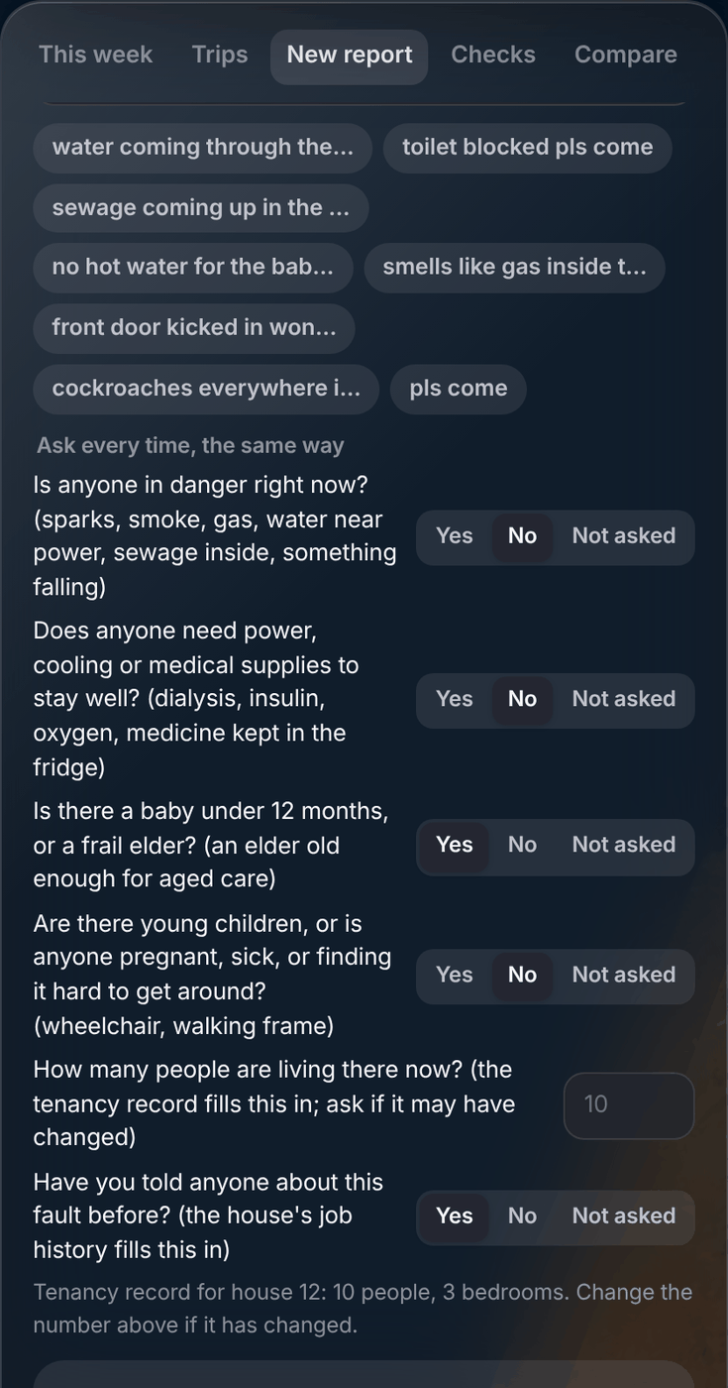
Fair to people who say less, or say it differently
Told in full
50 → 5
“toilet blocked, my nana lives here, 9 of us, third time I rang”
points a household lost for saying less (average)
Told in a few words to the housing officer
95% → 6%
“toilet blocked pls come”. Same house, same need. From the words alone, this example loses 45 points
of short reports ranked below the same household told in full
So everyone is asked the same six questions
13% → 89%
Anyone in danger now? Needs power, cooling or medicine; a baby under 1 or a frail elder (Tier 1)? Young children, pregnant, sick or hard to get around (Tier 2)? How many live there? Told anyone before? Records fill in the rest. "Not asked" never costs points.
of Tier 1 or 2 households recognised from a few words
Clock starts at first contact · free interpreters (AIS, TIS National, NRS) · how, when and in what language you report is never scored
Notes:
[AASHISH, about 40 seconds]
There's a quieter unfairness too. If points come only from what tenants say, "my nana lives here, nine of us, third time I rang" beats "toilet blocked, please come". Same house, same need.
So whoever the tenant tells asks the same six questions, with a free interpreter. Tier one, like someone on dialysis or a newborn, gets more points, and losing power or water becomes an emergency for them.
Across three thousand made-up households, saying less cost 50 points from words alone. With the questions, about 5.

Slide 7
Why we built it on Uber's H3 hexagon grid
Squares
Hexagons
Shared trips
Communities within 2 hexagons (about 90 km) can share a trip, saving $67–$76 per repair
Privacy
A house is stored as a small hexagon, not a street address
8 neighbours at 2 different distances
6 neighbours, all the same distance away
Public numbers
Waits are published per larger hexagon, only where there are at least 5 repairs
Why it matters: “two hexagons away” is the same distance in every direction, so deciding which communities can share a trip is fair to all of them.
Field and maps
"Nearby jobs" for tradespeople, the driving-time map, and fast database lookups
Notes:
[AASHISH, about 35 seconds]
This was my favourite decision. I suggested Uber's H3, an open-source grid of hexagons, and Harsh built the system around it.
A square's neighbours sit at two distances, sides and corners. A hexagon's six neighbours are all the same distance away. So "within two hexagons" is fair in every direction, and the rule for sharing a trip treats every community the same.
One grid does four jobs: shared trips, privacy, public numbers by area, and the maps.

Slide 8
Every week, an optimiser plans the trips
Two separate trips
One shared trip
$76
saved per repair by shared trips, against the same plan without them
Community A
Community A
17%
Hub
Hub
fewer days households live with a fault, because the saving buys more visits
Community B
Community B
99.5%
Two drives there and back
One loop: hub → A → B → hub
Google OR-Tools (CP-SAT) chooses which communities get a visit and which jobs are done, within each tradesperson's 40 hours, road closures and airstrips. Trades going to the same place travel together: a further $105 off every repair.
of 26,018 weekly plans proved the best possible, in milliseconds
Notes:
[HARSH, about 35 seconds]
Every week Google's OR-Tools plans the trips around crew hours, road closures and airstrips. A job running out of time gets a boost onto the next trip.
One tradesperson does one loop instead of two trips, and H3 tells us which pairs are close enough. That saves about $76 on every repair, and households spend 17% fewer days living with faults.
The solver proved 99.5 percent of twenty-six thousand weekly plans to be the best possible.

Slide 9
Fairness costs a little more, and saves months of waiting
 | Cheapest first | ReachNT
Average cost per repair | $561 | $821
9 in 10 urgent remote repairs fixed within | 62 days | 3 days
Days living with a fault | 233k | 62k
+47% cost, 74% fewer days with a fault
It held in all five random years we tested: 74%–77% fewer fault-days, for 45%–49% more per repair.
One simulated year on real NT geography: 37,508 synthetic repair requests, 70 communities, 5 trade hubs.
Notes:
[HARSH, about 45 seconds]
So what does it buy? A year of 37,508 made-up requests over the real Territory.
Planning for the cheapest jobs costs $561 a repair. ReachNT costs $821, about 47% more.
For that, nine in ten urgent remote repairs are fixed within 3 days instead of 62, and households live with faults for 74% fewer days. Against a cheaper plan that also guarantees urgent jobs, ReachNT costs 5% more for 29% fewer fault-days.
We ran five random years. The result held every time. The trade-off should be visible, priced, and signed by a person.

Slide 10
Floods: surge crews, not other communities' trades
Make every house safe within 48 hours
Modelled flood: Kalkarindji, Daguragu, Pigeon Hole
Maintenance and housing officers check each one; danger is made safe that day
94 repairs, roads cut for 4 weeks (like January 2023). 9 in 10 urgent repairs fixed within:
One team, one trip
In the flooded communities
Plumber, electrician, carpenter and maintenance share the vehicle or the plane
14 days
3 days
Surge crews from the contractor panel
usual crews
surge crews
Local Aboriginal Business Enterprises first; a named person signs the request
Everywhere else in the hub (3 with no flood)
10 days
3 days
Tell every household
usual crews
surge crews
Hotline, housing officer, free interpreters; every report tagged to the event
Dangerous faults the reader recognised were made safe within a day (we assume a maintenance officer on hand).
Live NT Road Report and Bureau of Meteorology readings prompt the coordinator: a road closure, heavy rain (“Declare a flood?”) or heat for Tier 1 homes. A person decides.
Notes:
[AASHISH, about 35 seconds]
Floods hit whole communities at once. The coordinator declares an event: every house made safe within 48 hours, one team trip, and surge crews from the contractor panel.
In a flood like January 2023 at Kalkarindji, the usual crews took 14 days, and the rest of the region slipped from 3 to 10. With surge crews, both stayed at 3.
The portal reads the NT Road Report and the Bureau of Meteorology, so heavy rain prompts the coordinator. It prompts; a person decides.

Slide 11
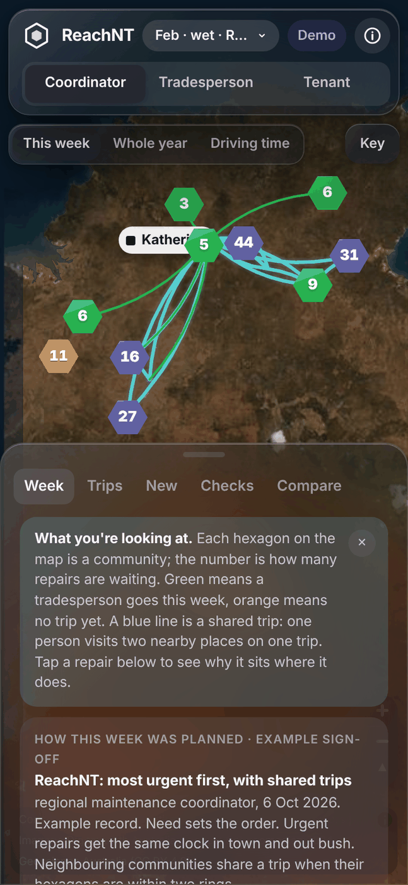
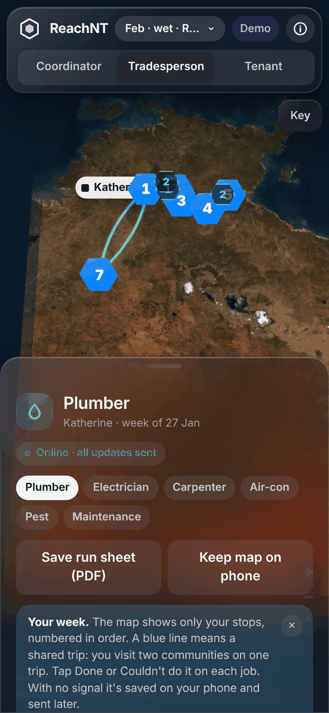
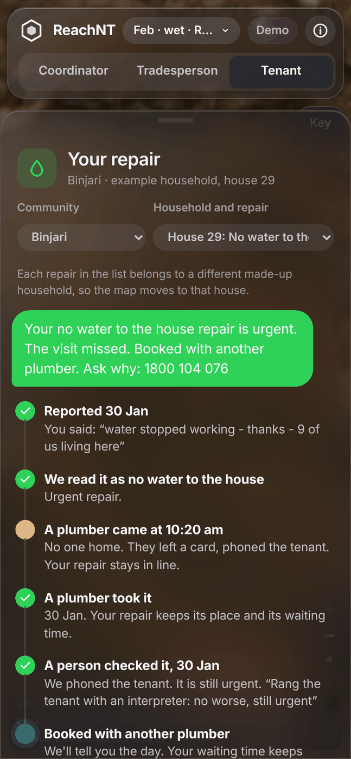
Live now, on a real satellite map, and on any phone
Coordinator
Tradesperson
Tenant
Anyone the tenant tells can log a report, with the same questions
Works without signal: updates are saved on the phone and sent later
Plain words, WCAG 2.2 AA checked, PDFs, no confidence percentages
reachnt.vercel.app
Notes:
[HARSH, about 60 seconds, including a 40-second live demo]
This is the working prototype, live at reachnt dot vercel dot app. Each hexagon is a community, the number is repairs waiting, and the blue lines are shared trips.
[Live demo, 40 seconds, practised beforehand (Early Feb, ReachNT plan): Tradesperson (plumber), tap Done on the first card, Binjari house 29. Housing officer, switch community to Binjari, house 29: "Still broken", Record. Coordinator, Checks, scroll to "Tenant says it's still broken", "Choose a crew", pick crew B, Send. Tenant: it opens on that repair, showing the reopened timeline.]
Tradespeople get a run sheet that works with no signal, and tenants see every week their repair waited, and why.

Slide 12
People stay in charge, and tenants can push back
A named person signs the trade-off
How much cost may count is a signed decision, kept in a tamper-evident record
A person can change urgency at any time
From a call, a visit, a photo or a review. Lowering danger needs someone who spoke to the tenant or saw it
A missed visit is never closed, and keeps its place
Time and what was tried are recorded; then the next trip, another crew, or anyone who can go sooner
No app needed: the housing officer acts for the tenant
Fixed, still broken, got worse or a review. A fix that didn't hold moves up the line
People check the AI every week
1 in 20 reports the computer read alone is re-read by a person
Personal details locked away
Names, phones and addresses in an encrypted vault; the house is just a hexagon
Notes:
[AASHISH, about 35 seconds]
Because this affects people's homes, people stay in charge.
A named coordinator signs how much cost counts. A person can change urgency any time, on a call, on site or from a photo, and lowering a dangerous repair needs someone who spoke to the tenant or saw it.
A missed visit is never closed: it goes to the next trip or another crew, keeping its waiting time. And no app is needed: the housing officer can record anything for a tenant.

Slide 13
What we tested, and what we can't claim yet
Tested
Not yet
148 automated checks on every code change: data, the reader, fair intake, the planner, the server
The repair requests and households are synthetic: no public NT repair data exists
Five random years of requests; the result held in all five
The reader is tested in English only. Tenants speak Kriol, Aboriginal English and many languages
Every community's position checked against satellite photos
No community has reviewed it yet. That comes first, not last
Accessibility: 0 WCAG 2.2 AA issues in every view
Our test kit is ready the day real reports arrive, labelled with the Aboriginal Interpreter Service
Security: locked-down site, validated inputs, sign-in rules ready
Notes:
[HARSH, about 40 seconds]
We want to be straight about what we've proven and what we haven't.
We have 148 automated checks on every change, five random years, every community's location checked against satellite photos, and an independent audit whose findings we fixed.
But the requests are synthetic, because no public repair data exists. The reader is tested in English only. And no community has reviewed this yet. That's why our first recommendation is about people, not code.

Slide 14
What we recommend
1
Make the trade-off a signed decision
Publish the triage rules, ask every tenant the same questions however they report, and record who decides how much cost may count.
2
Pilot in one region, with communities
Start with the Katherine hub's 16 communities, co-designed with tenants, Aboriginal Housing NT, land councils and the Interpreter Service.
3
Test the AI on real words first
Score the reader on real reports in Kriol and Aboriginal English before it reads a single one on its own.
Notes:
[AASHISH, about 30 seconds]
Three recommendations.
One: make the trade-off a signed decision. Publish the rules, ask every tenant the same questions, and record who decides how much cost counts.
Two: pilot it in the Katherine hub's sixteen communities, designed with tenants, Aboriginal Housing NT, land councils and interpreters.
Three: test the AI on real words before it reads anything on its own.

Slide 15
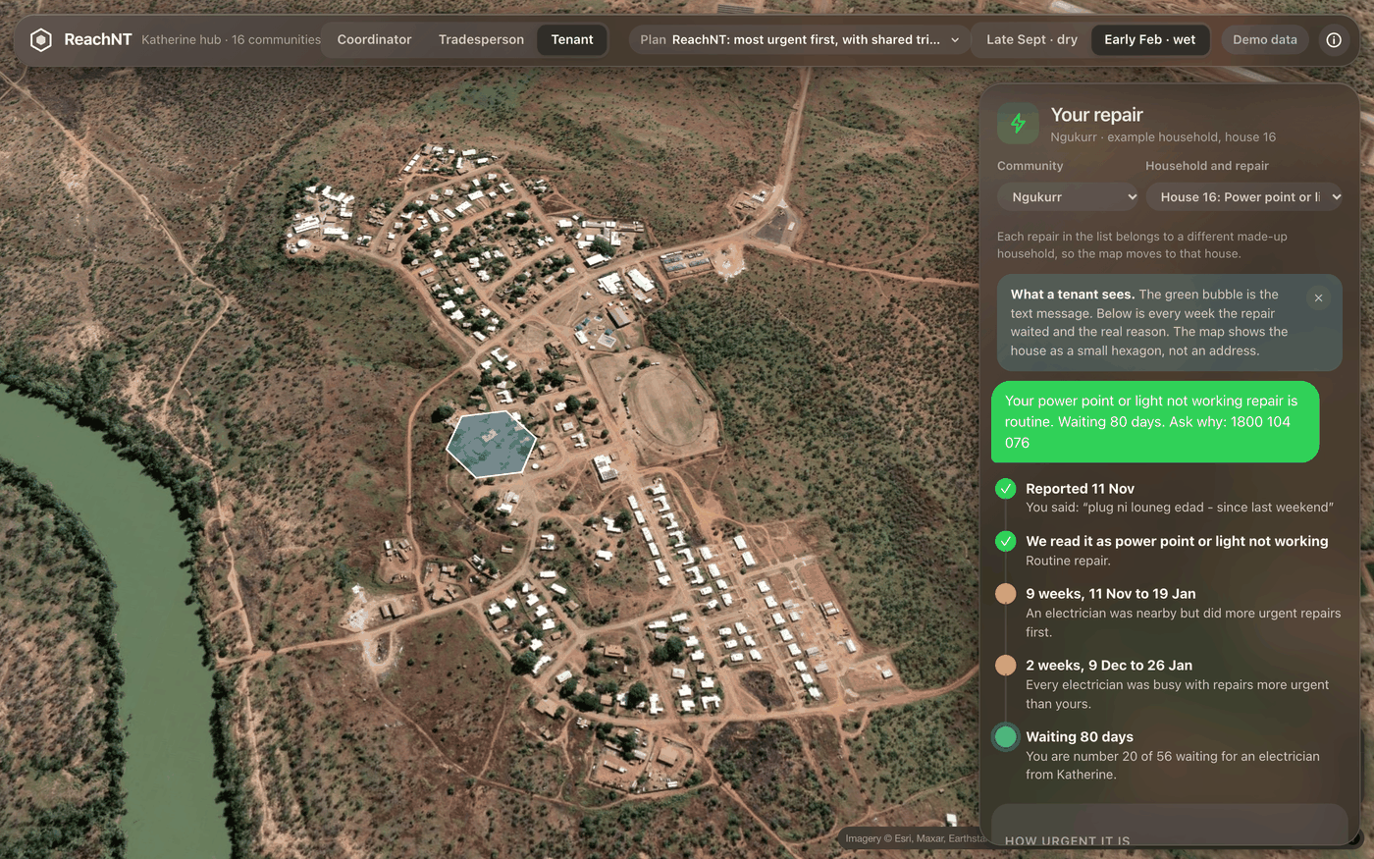
Where someone lives shouldn't decide how long they wait
ReachNT fixes 9 in 10 urgent remote repairs within 3 days instead of 62, for 47% more, and makes someone own that choice.
reachnt.vercel.app · github.com/harshrastogii/reachnt
Thank you. Questions welcome.
Notes:
[HARSH, about 20 seconds]
To finish: where someone lives shouldn't decide how long they wait for water, power or a safe home.
ReachNT fixes urgent remote repairs in days instead of months, for a cost we can see and name, and it makes someone own that choice.
Thank you. We're happy to take questions.

